Slide 1

Directorate of Technical Education Rajasthan, Jodhpur
Kaushal Darpan​
Version 1.0
User Manual for Student Flow for Examination-
08-04-2025

Slide 2
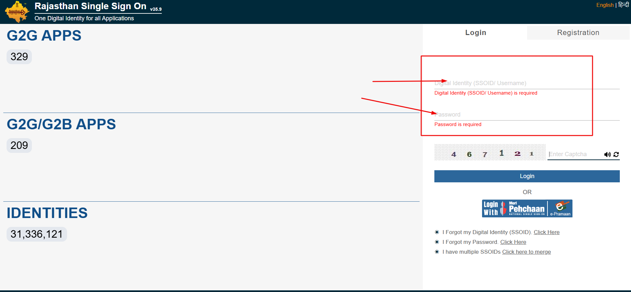
Login through SSO

Slide 3
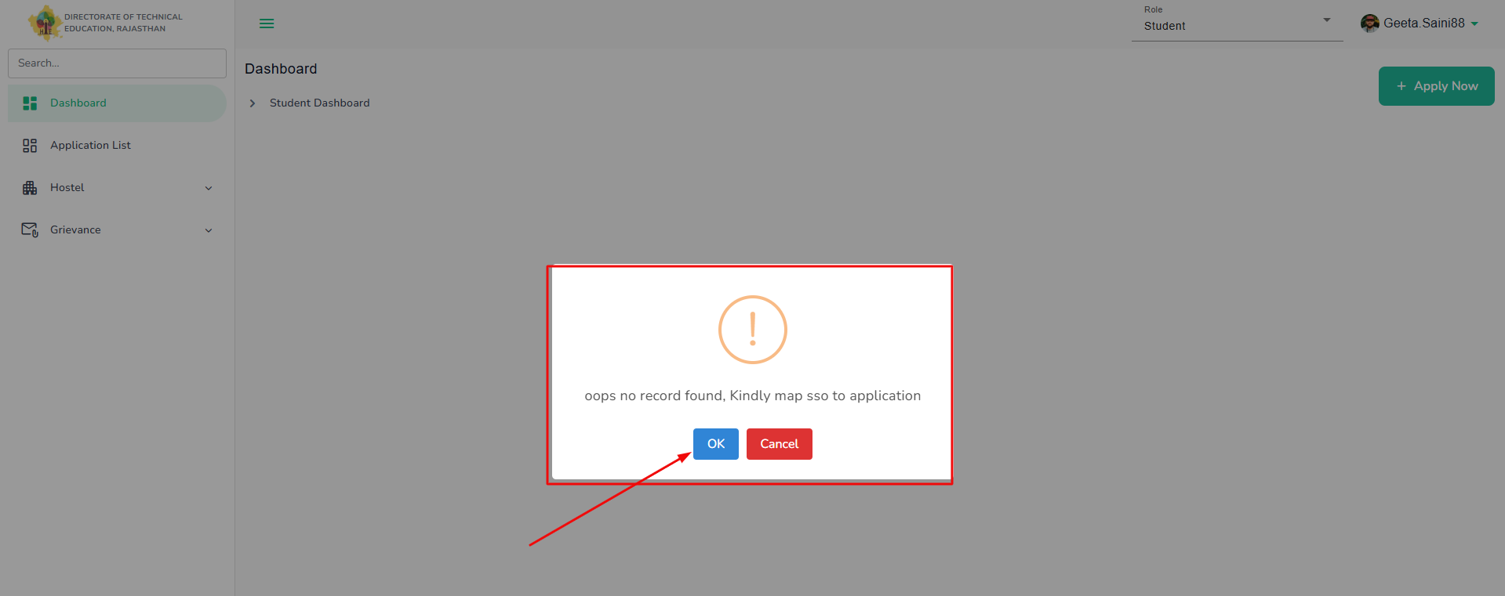
Map with Application (if not mapped)​​. Click on OK and proceed for mapping process

Slide 4
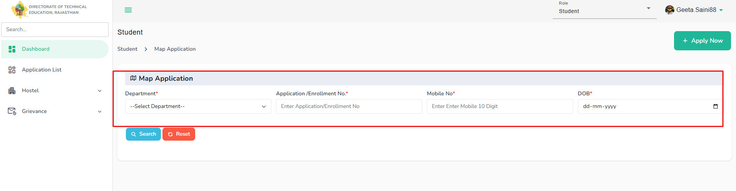
Provide the asked mandatory details to map with application and click on search. Student details will be auto-fetched from the system based on the details provided.

Slide 5
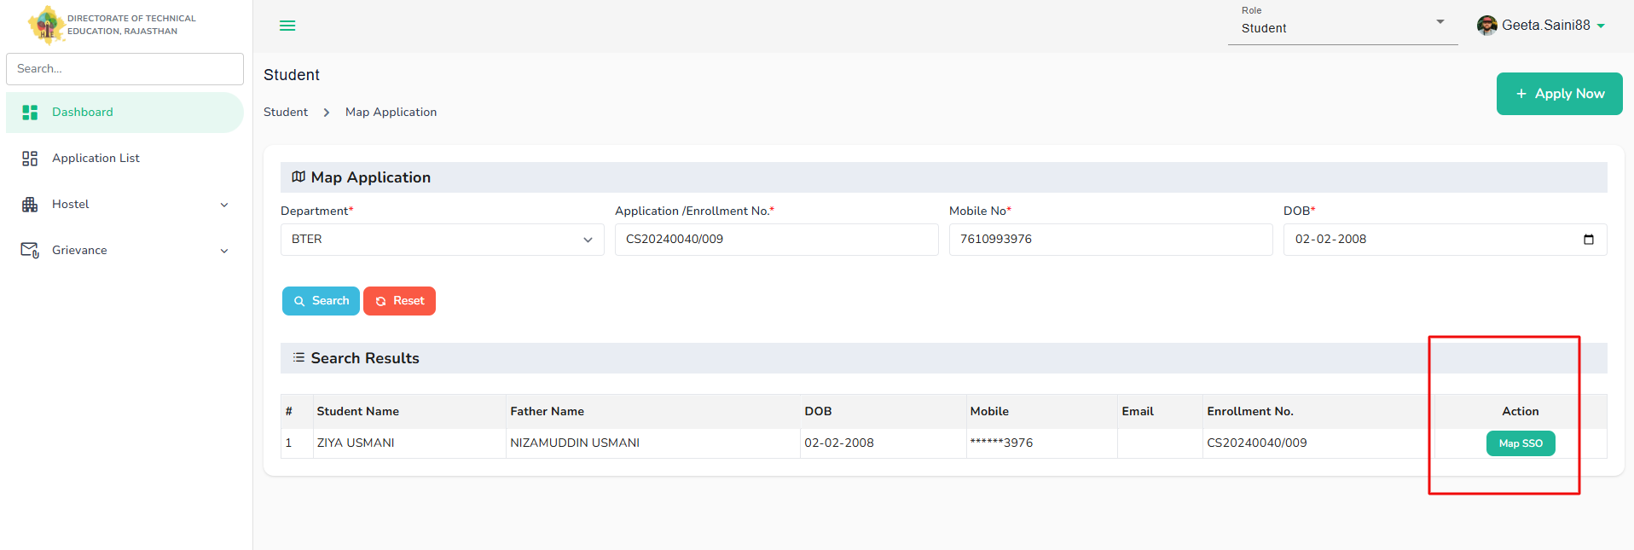
Details will be auto-fetched and map sso button will be display under action. When click Map SSO student details will be mapped with sso and details will be auto-fetched and displayed under student dashbaord.

Slide 6
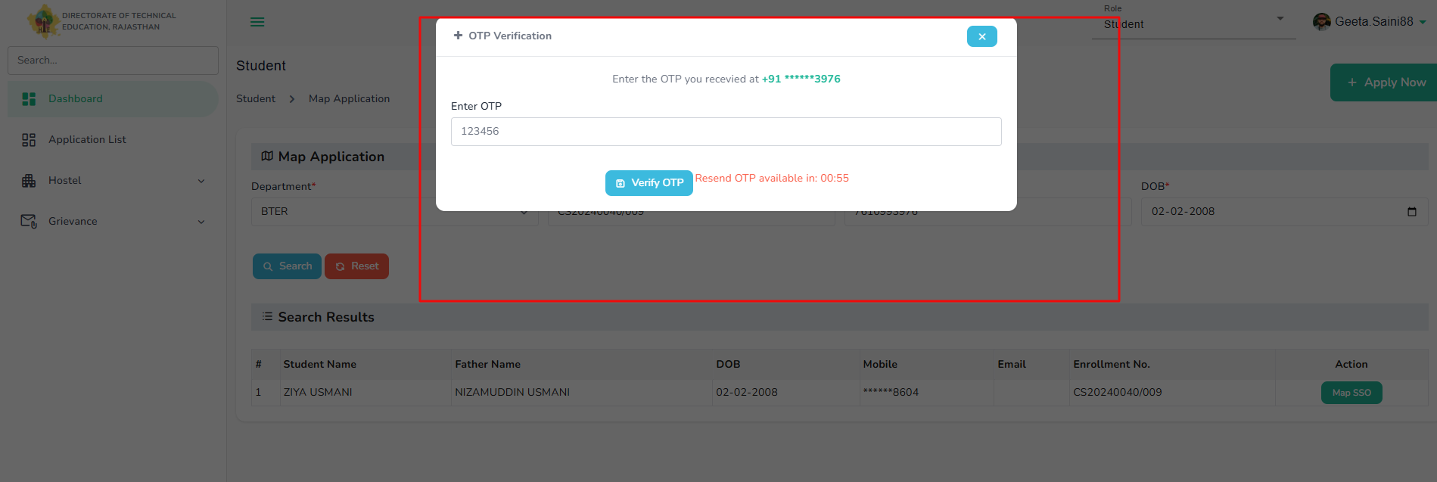
To map with application, verify the student details with otp verification which will be sent on the registered mobile number of the student during admission.

Slide 7
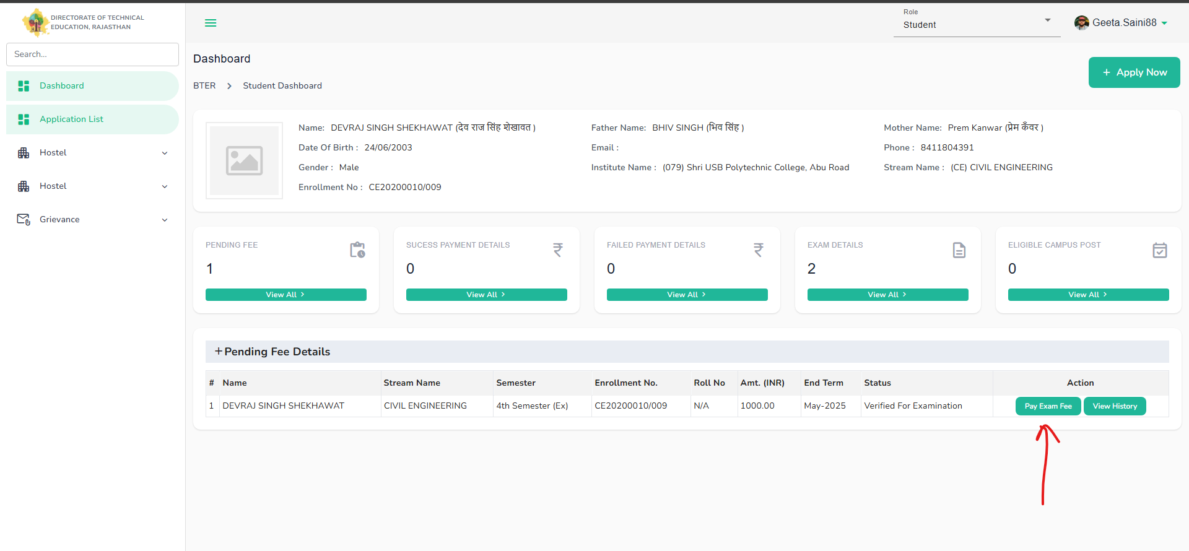
Student successfully mapped with application and details displayed in student dashboard to pay fees after getting updated status by principle-> verified for examination.

Slide 8
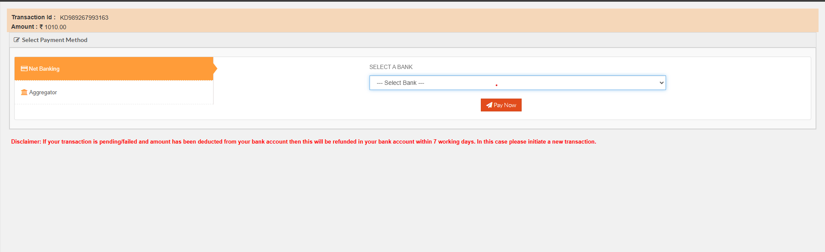
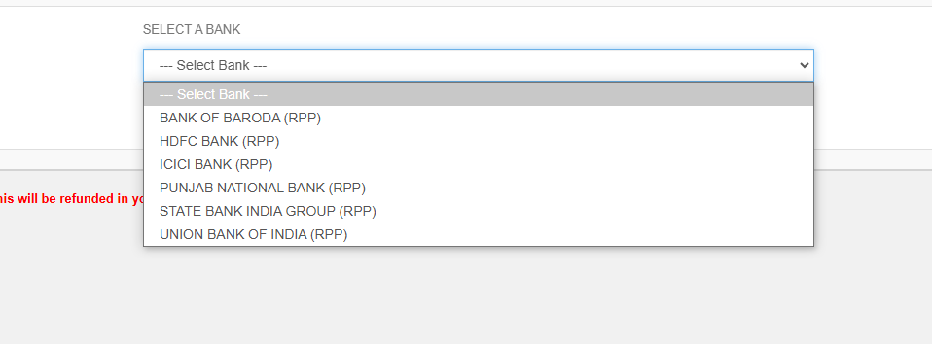
Student when click on pay fees redirect to payment screen to complete payment for examination.

Slide 9
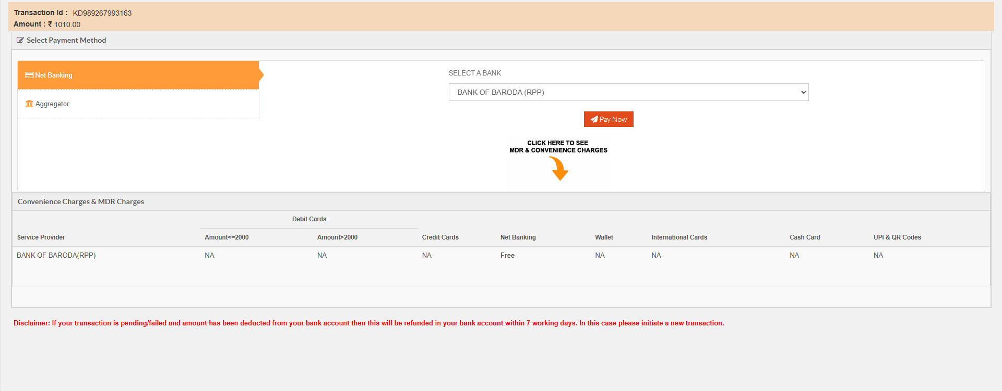
Student after selecting payment mode, payment details will display and click on pay to complete the payment process.

Slide 10
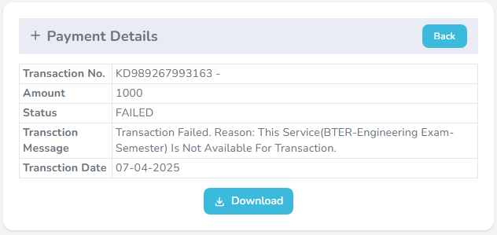
After successful payment, student will get the payment details receipt with all the details. Student will be able to download the receipt by clicking on download button.

Slide 11
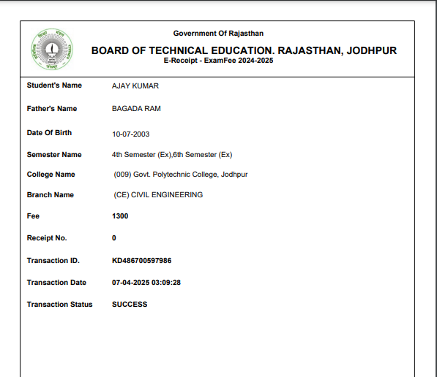
Student can view the payment successful fees receipt from their dashboard where they can check all details.

